Slide 1
Multi-cloud CNF deployment with the ODA Canvas
Cece LI
System Architect, Whale Cloud

Slide 2
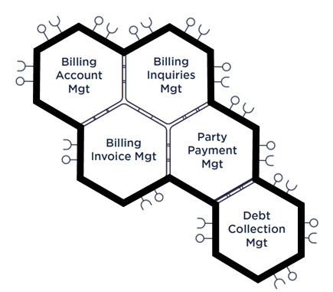
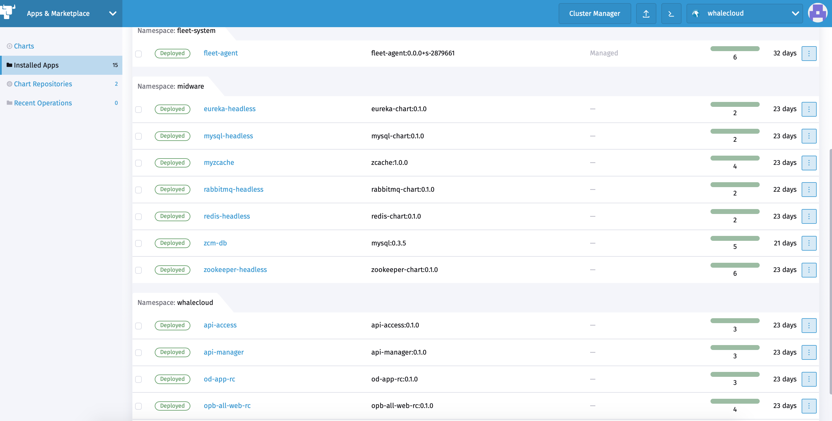

ODA Canvas on Multi Cloud
Delivered an execution environment for ODA reference implementations based on standard Kubernetes infrastructure
Standard ODA Component Helm Chart for ‘click-to-deploy’ which could be easily implemented in Multi Cloud
Compatible with multi Cloud management systems
CI/CD Release
ODA Canvas
The ODA Canvas comprises the execution environment as well as the release automation part of a CI/CD
API Gateway
Runtime Environment (eg Kubernetes)
Service Registry
Load Balancing
Logging
License Manager
Service Discovery
Service Mesh
Authorization
Event Hub

Slide 3
ODA Demo TMFC006 Service Catalog

Slide 4
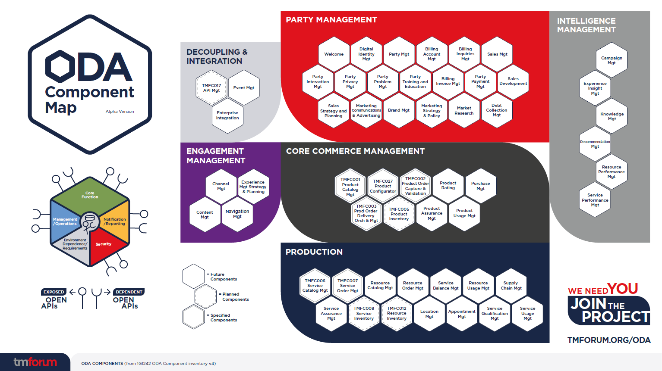
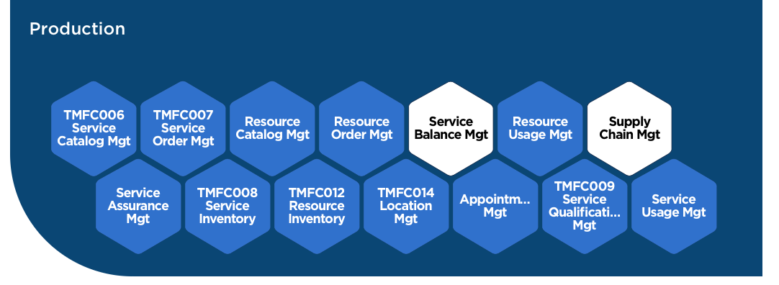
TMFC006 Service Catalog Management
5G Operation
in ODA Canvas

Slide 5
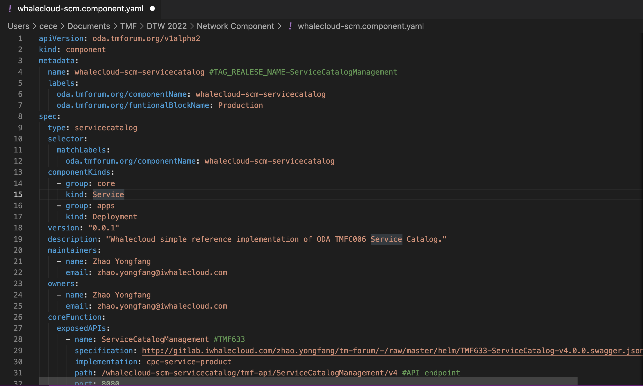
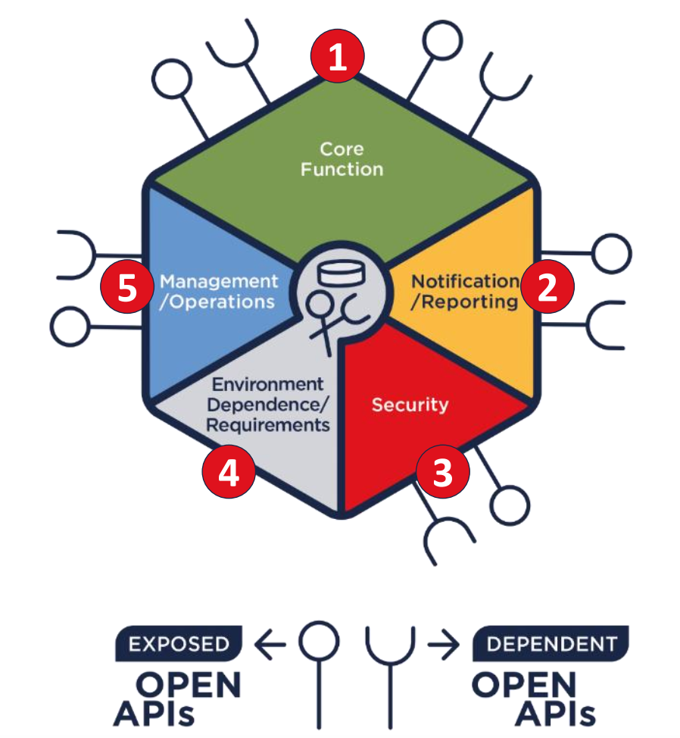
Helm Chart for TMFC006

Slide 6
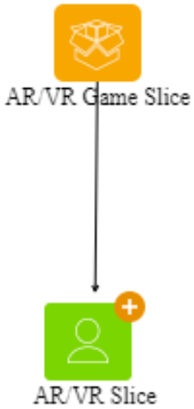
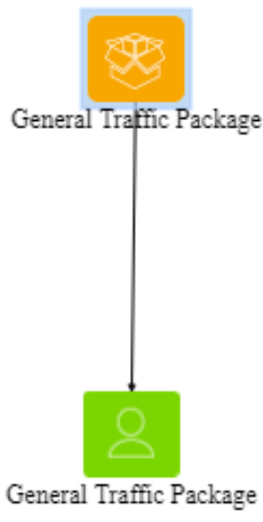
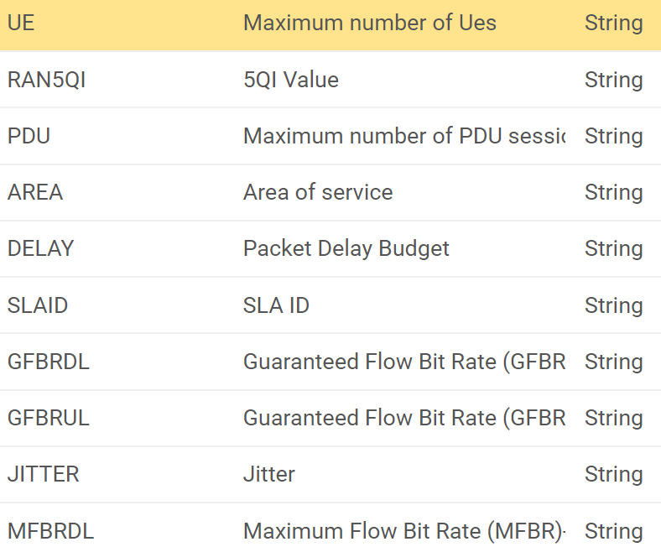
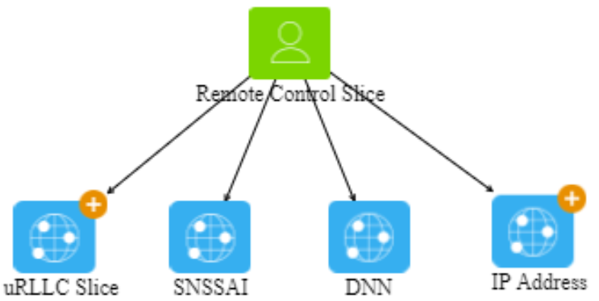
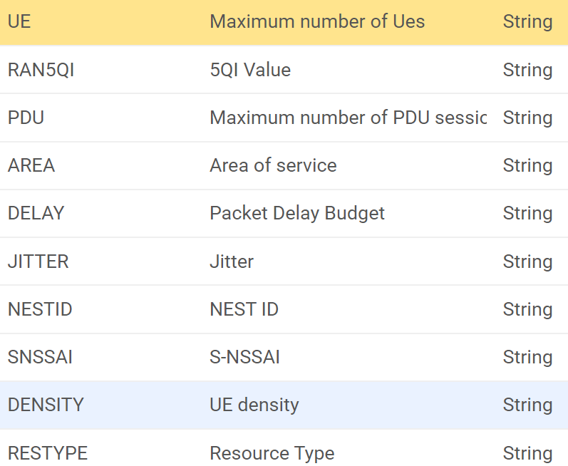
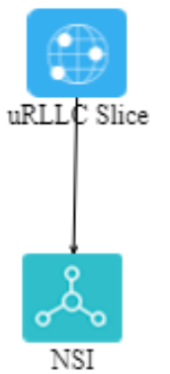
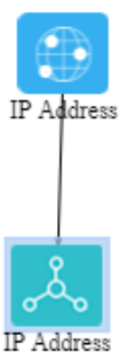
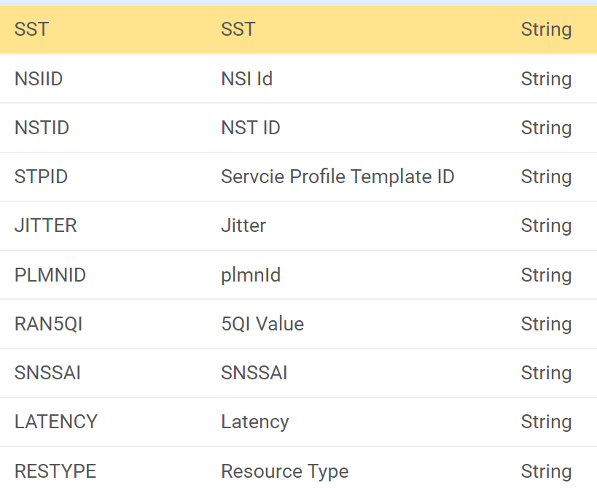
5G Service Modelling in TMFC006
Non-stop bottom to top service modeling and prebuilt 5G service catalogs to shorten TTM of 5G product & services
Product
Specification
GUI based
5G FWA
5G Slice
5G Mobile Data &Voice
Product
CFS
Specification
...
Drag & Drop
5G Gaming Slice Service
...
Mobile Service
FWA Access Service
CFS
eMBB
Slice
Model Reuse
CPE
Service
DNN
Service
VLAN
Service
RFS
VLAN
...
RFS
Specification
Number
NE
NSSMF
Network slice
Circuit
Resource
...

Slide 7
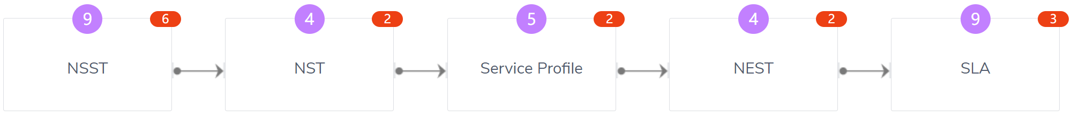






5G Slice Design in TMFC006
Pre-built slice templates from existing projects assists Post to easy configure right E2E slice template for different vertical requirements
E2E Slice Template Model
NST Attributes
Constituent
Policy
Capability
NST ID
RAN NSST ID 1
Policy 1 {}
Flavor1 {capabilities}
NST Name
Transport NSST ID 1
Policy 2 {}
Flavor2 {capabilities}
Reusable
Version
Core NSST ID 1
Policy 3 {}
Flavor3 {capabilities}
Slice Type
Core NSST ID 2
Policy 4 {}
Flavor4 {capabilities}
…
…
…
…
Configure
Bottom-to-Top Slice Structure
Standard
GUI based
Applied to
Applied to
Applied to
Applied to
Slice Resource
Specification
Slice RFS
Specification
Slice CFS
Specification
Slice Product
Specification
Flexible

Slide 8
Reference
Our Customers’ Success is Our Success!
European
A operator
A operator in Southeast Asia
B operator in Southeast Asia
A operator in South America
A operator in Asia Pacific
A operator in China
Building Digital OSS on Public Cloud in 4 Months
Fixed network customers grow 35 times from 2015 to 2021
Leverages ZSmart QRun for FTTx Fast Construction
Accelerates the progress of optical network deployment
A full-stack project takes less than 10 months to go live
FMC transformation leader in China Market

Slide 9
ODA Demo PCF – ZSmart Policy Manager

Slide 10
PCF in ODA Map
5GC
PCF
CHF
AMF
SMF

Slide 11
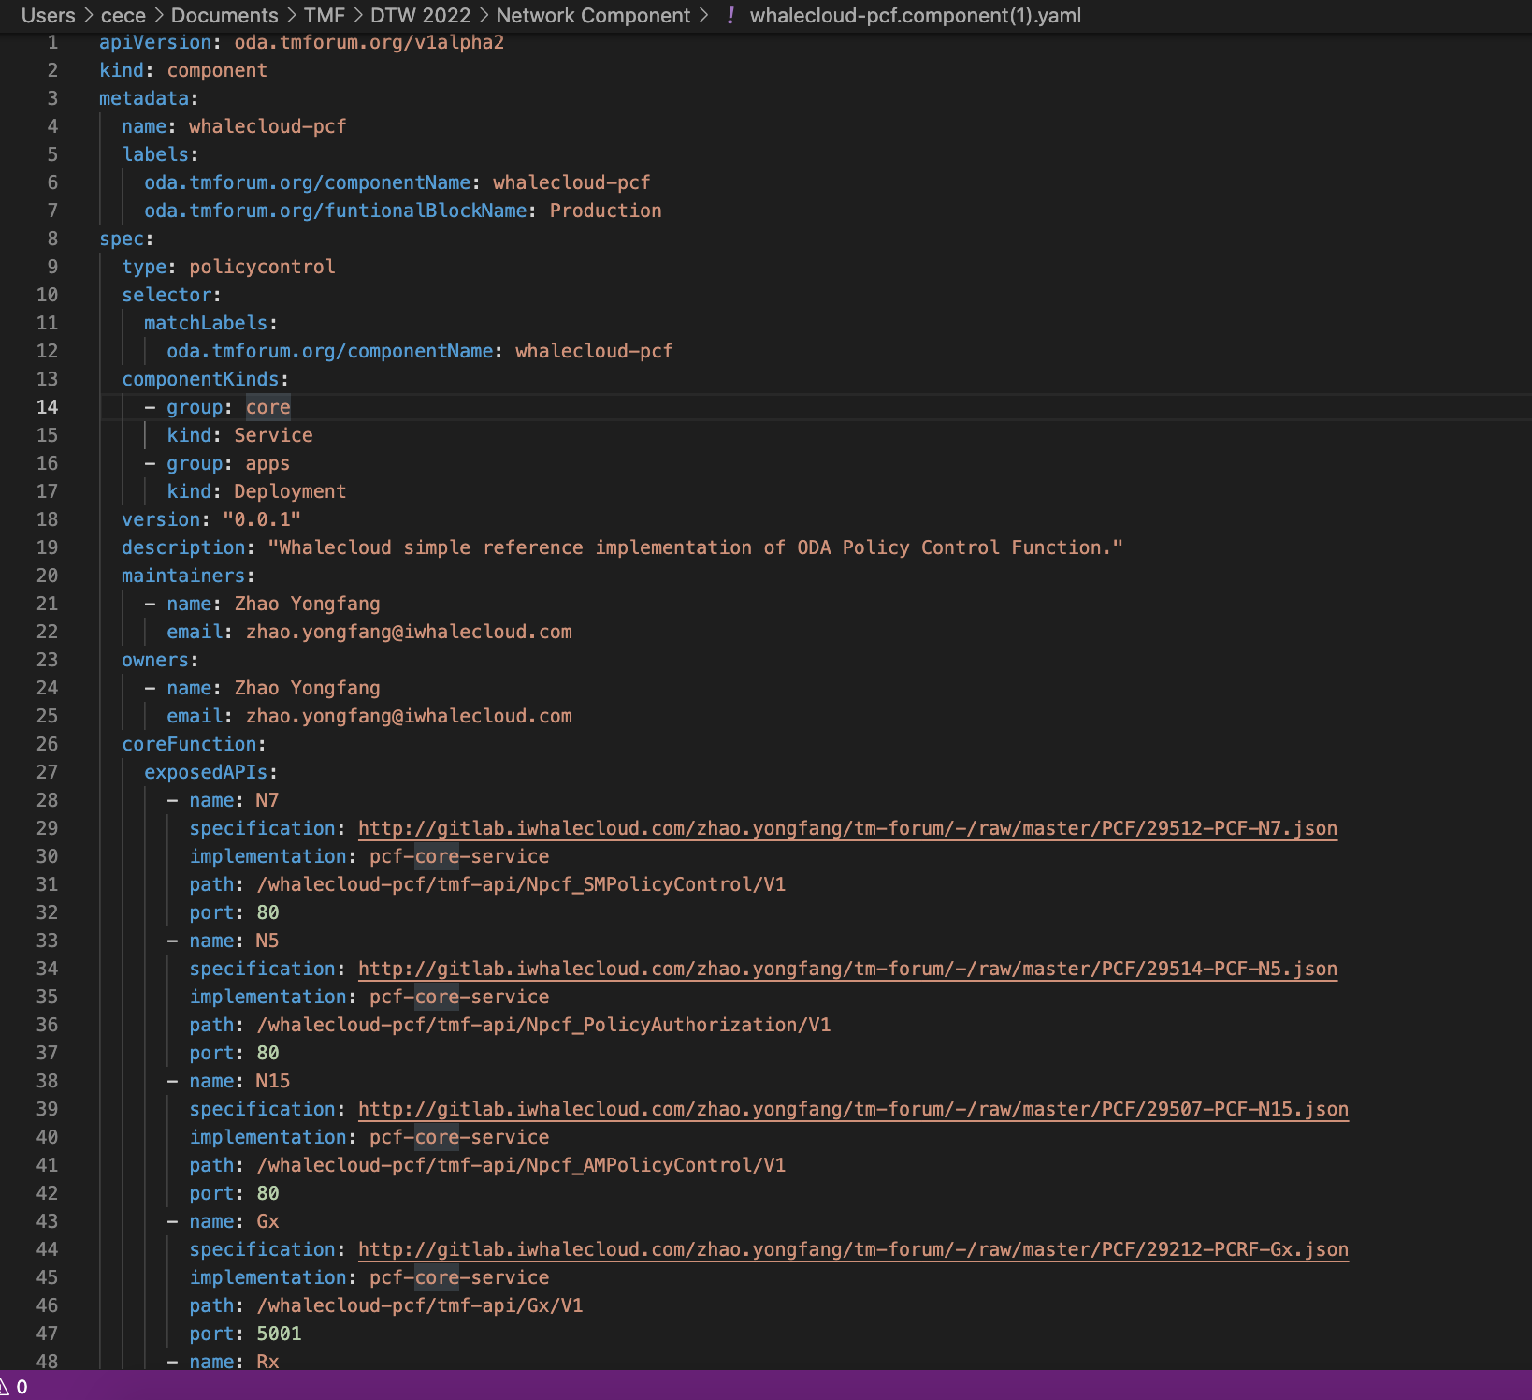
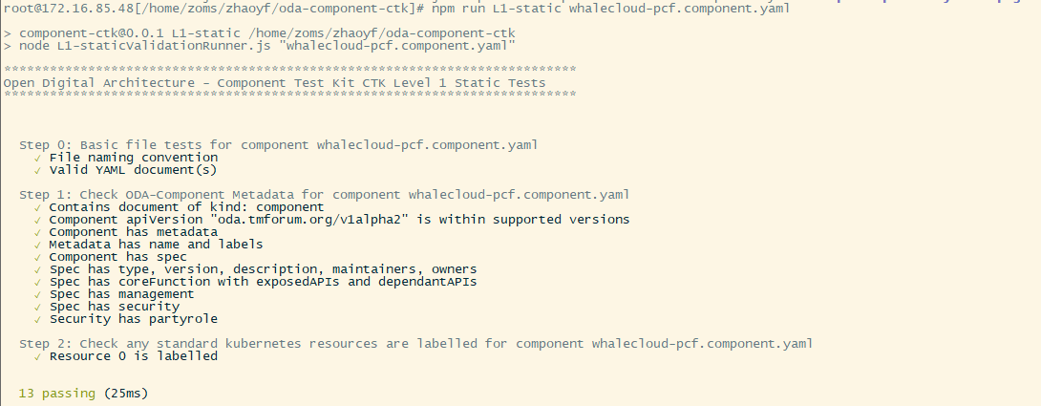
Helm Chart for PCF
CTK L1

Slide 12

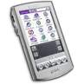
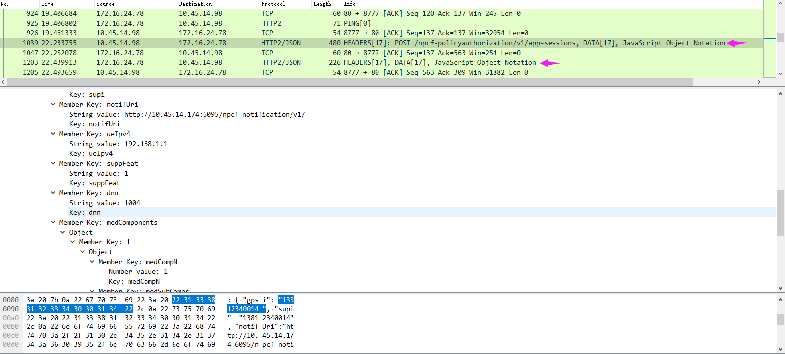
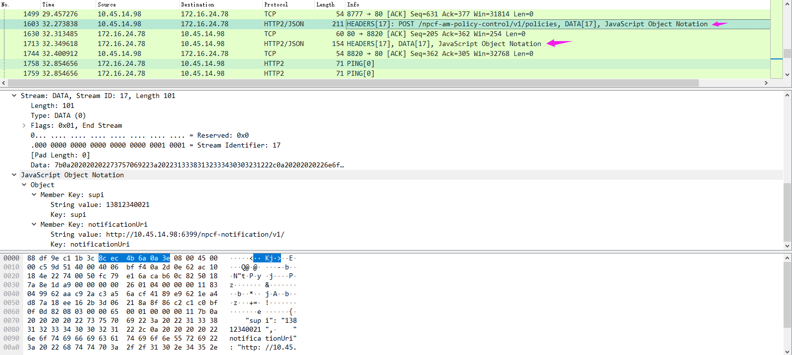
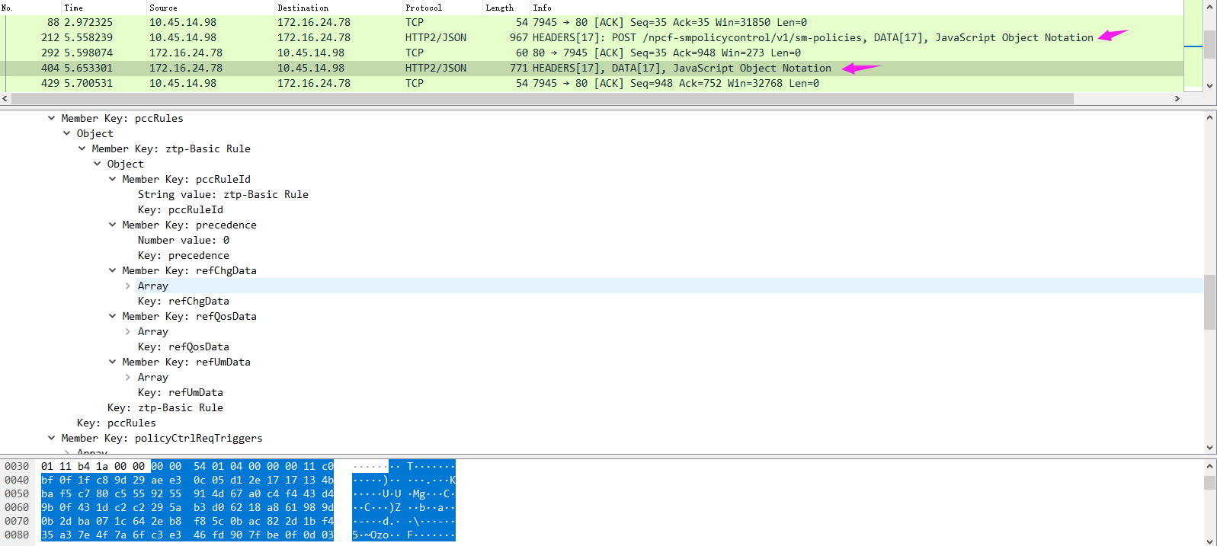
Standard Compliance: 3GPP PCC Architecture
External Systems
Legend
ZSmart Policy Manager for 5G:
Hybrid Architecture
SBI interface to 5GC
DCC(Rx, Sy, Gx) interfaces to interact with EPC, OCS and AF.
Convergence Policy control architecture for 2G/3G/4G/5G
Multiple interaction modes with SCP (Service Communication Proxy)
Any Network
Non-Standalone (NSA)
Standalone (SA)
ZSmart Integrated PCC
Enhanced OCS conditions-based policy, consistent data source.
Unified mgmt. of policy and charging, shorten TTM by the one-time configuration of policies and charging.
Hardware capacity sharing, simplified integration to reduce TCO & low risk.
Restful API
Mandatory
Optional
ZSmart Integrated PCC
Restful
Rx
ZSmart Policy Manager
Nnrf
DCC
VoIP
IM
Video
SPR
NRF
SBI
PDE
Policy Rule Mgmt.
P-CSCF
Centrex
PCRF
Policy Manager
AF
N5
PHub
External System
N15
Sy
N28
OCS
CHF
N7
Gx
N40
SMF
AMF
Gy
3G/4G
5G
Radio
Access
SGSN/S-GW
PCEF
Internet
UPF
RAN
5G NR
GW
N5
N15
N7

Slide 13





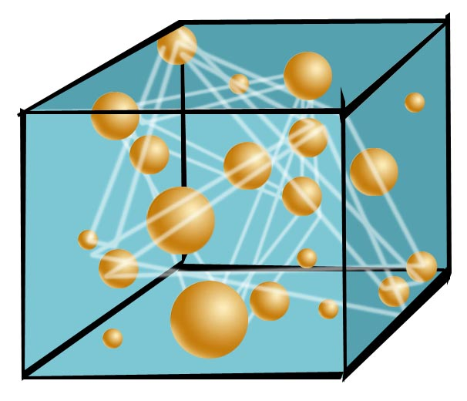




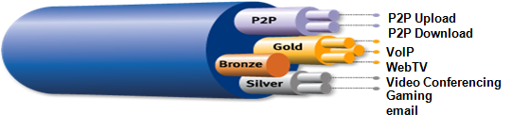

ZSmart Policy Manager Monetizing your Data easily and swiftly in 4G & 5G Era
Based on the cloud architecture, ZSmart Policy Manager provides a unified policy control center for various networks, which not only enables users / services to have different QoS and charging experiences under various conditions, but also improves the data profitability of CSPs and extends the business model beyond network optimization.
Multiple Conditions
Policy Control
Comprehensive Actions
Service
QoS
AF
16:00 ~ 22:00
MON ~ FRI
Time
Gating
Network
ZSmart Policy Manager
WAP
3G
4G
NET
5G
WLAN
Location
Notification
PCEF/SMF
Usage
Email
Redirect
SMS
Subscription
Billing

Slide 14
Reference
ZSmart Policy Manager has over25 sites around the world, serving hundreds of millions of subscribers.
…
Another 3 operators
In Asia Pacific
ZSmart Policy Manager has successfully finished IOT with IMS & EPC from different vendors in different projects in 3 countries in the APAC region.
A European operator
Fully cloud-based Telco solution.
Enable the operator to focus on digital services and vertical services.
2 operators
in Asia Pacific
2 operators in 1 country, over 681 million subscribers..
The powerful and stable integrated PCC architecture helps the operators to rapidly grow into the top operators in the country.
A multinational
operator
1 of the top network operators in the world.
ZSmart Policy Manger has been validated and certified by the operator‘s Skill Center, and has been successfully launched in many branches in Asia Pacific, Middle East and Africa.

